Slide 1
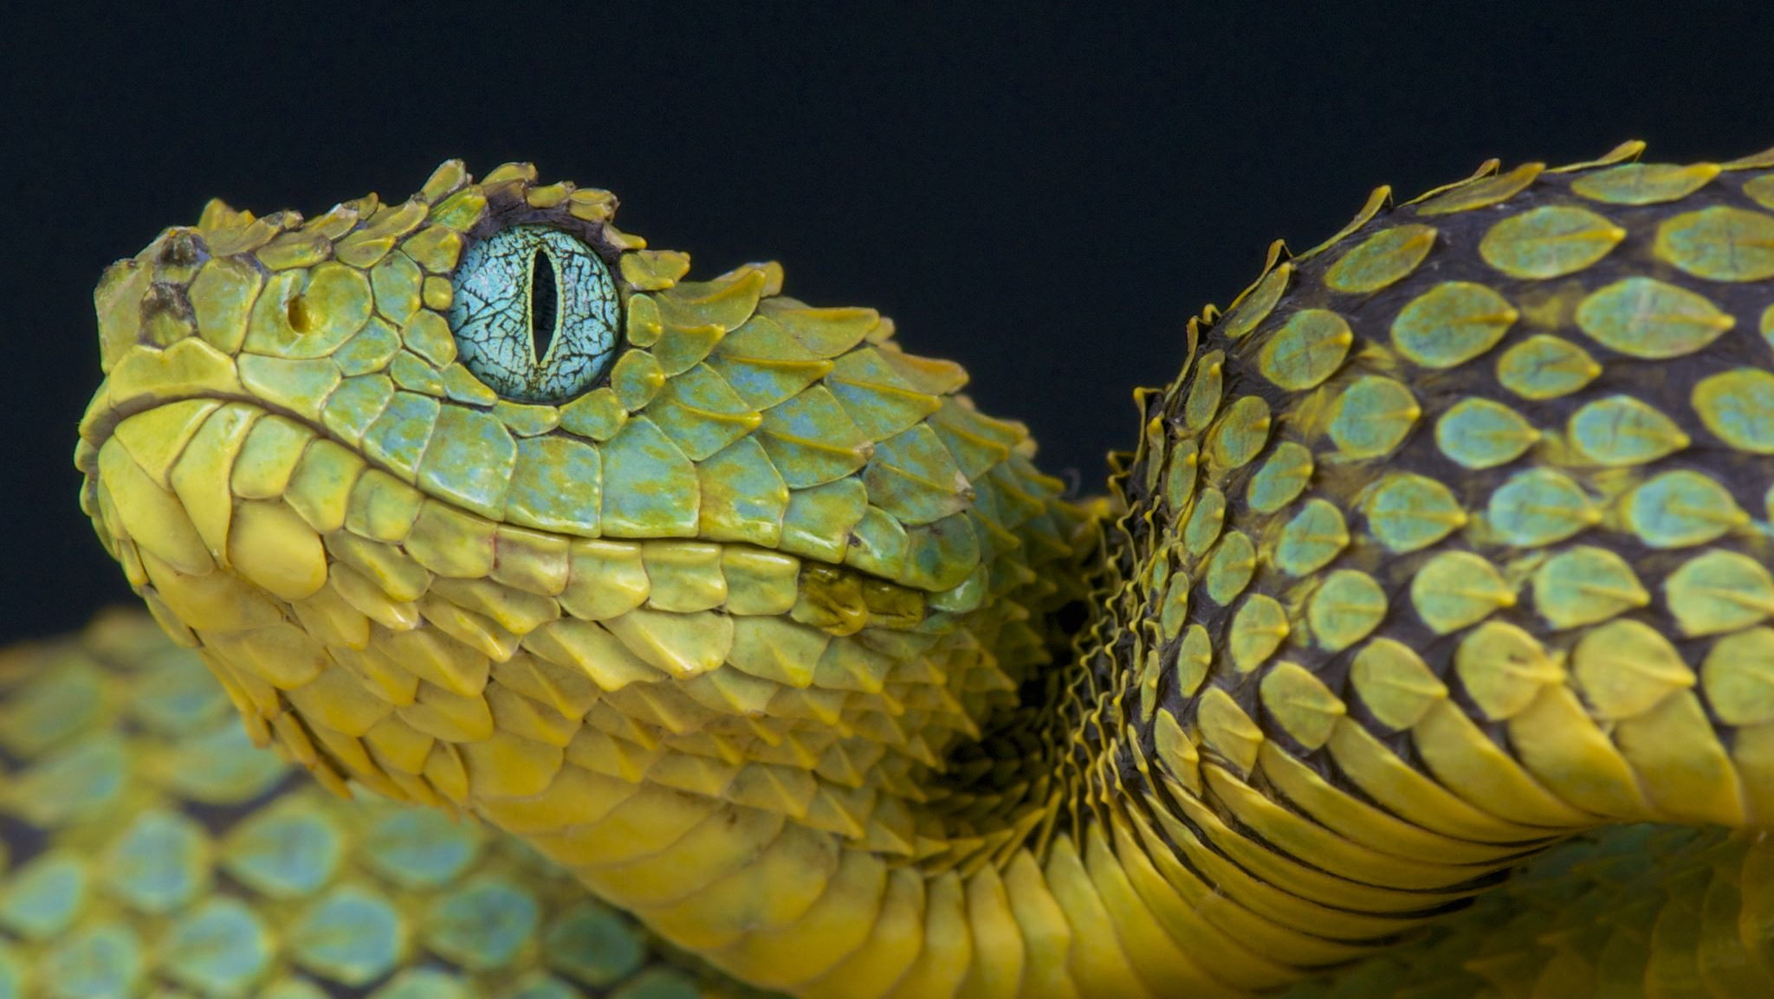
Python Workshop
Carpenter Lab

Slide 2
Quick Review

Slide 3
In Regex, what do the following search terms look for?
\w
\t
\s
\r or \n
\d
*
Word (including letters, numbers & underscore)
tab
White space character, including spaces, tabs & end of line
End-of-line (Python will use \n, TextWrangler uses \r)
Digit 0-9
Any letter, number or symbol except end-of-line characters

Slide 4
In Regex, what do the following search terms look for?
^
$
Beginning of line
End-of-line

Slide 5
Navigating your computer from the shell

Slide 6
Commands
ls
pwd
cd
rmdir
cp
mv
less
nano
List contents of directory
Print the name of working directory
Open directory
Remove directory
Copy file
Move file
View file
Edit

Slide 7
Recap from last week’s lesson
DNACalc.py
len()
Used variable types int(), float(), str()
Used # for comment lines
Printed strings and numbers
Formatting: %d, %.2f, %s
User input using raw_input()
String functions .count(), .replace(), .upper()

Slide 8
Chapter 9
Decisions & Loops

Slide 9
Chapter 9: Decisions & Loops
Python interactive prompt
Use of dir() function
help() – extension of dir(), help(list) or help(str)
Add more calculations on your dnacalc.py
Review logical operators
Notes:
1) Python interactive prompt
You can write a whole program to do things for you, but Python also has an interactive prompt that allows you to test something on the terminal window. You can try this out with me on Spyder to get exercise! Let’s all try it on Spyder right now. P. 152 on book
Note that the book may show something different. The correct answer is: int(float(x)/2)
2) Dir ()
Dir() fuction lists all the variables & methods nested within a specific variable. Here you’ll see .replace() & .upper() that we used last time. You will also see some names that begin & end with _,
print(b)
3) Add more calculations to our dnacalc.py
Go to p 144 of book. Let’s all open dnacalc.py
4) Review logical operations (next slide)

Slide 10
Python comparison operators: TRUE or FALSE
Comparison | Is true if..
x == y | x is equal to y
x != y | x is not equal to y
x > y | x is less than y
x < y | x is less than y
x >= y | x is greater than or equal to y
x <= y | x is less than or equal to y

Slide 11
Python logical operators: TRUE or FALSE
Comparison | Is true if..
A and B | Both A & B are true
A or B | Either A or B is true
not B | B is false (inverts the value of B)
(not A) or B | A is false or B is true
Not (A or B) | A and B are both false

Slide 12
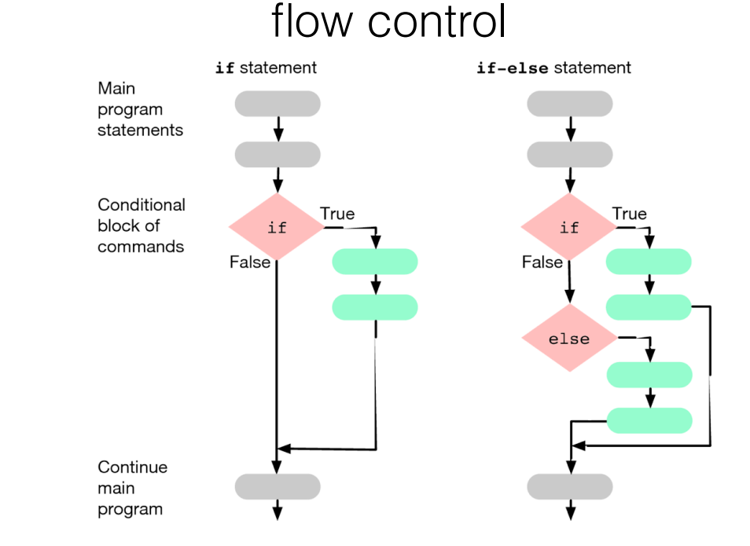

Slide 13
If Statements
SeqLength >= 14
SeqType == ‘DNA’
Latitude > 30 and Latitude < 40
30 <Latitude <40

Slide 14
Chapter 9: Decisions & Loops
Go back to DNAcalc.py and insert new lines
Melting Temperature using if-else statement
Notes:
Go back to DNA calc.py
----
Melting temperature using if else statement

Slide 15
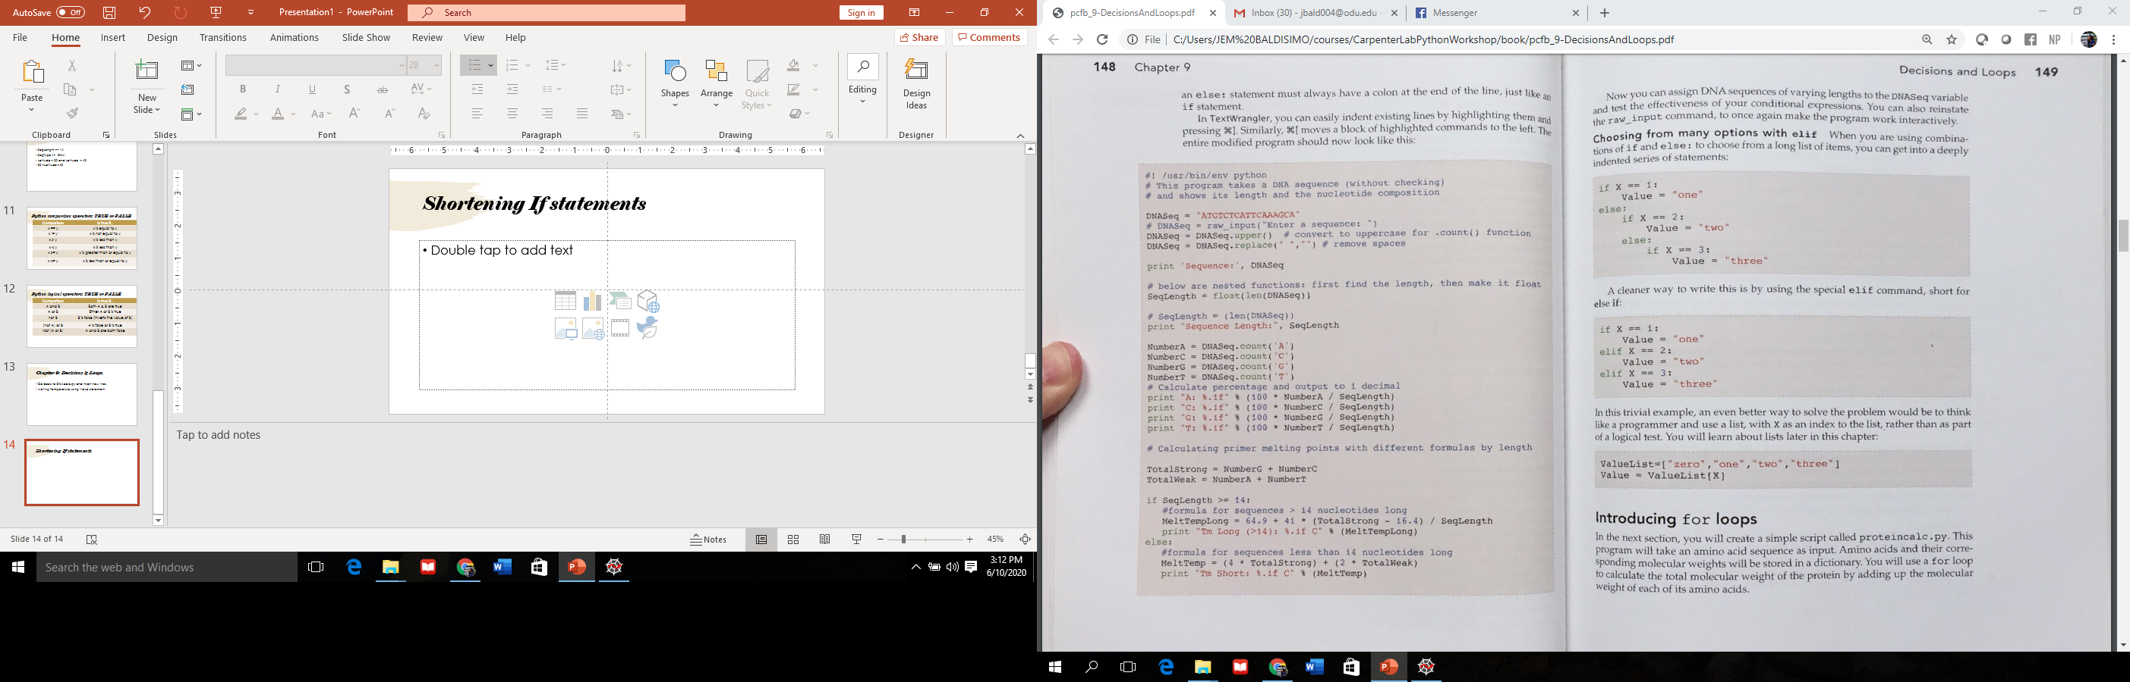
Shortening If-Else statements
Notes:
You can use elif to streamline your If statement.
On the left, you have 8 lines and it can get confusing for some, especially if they mess up the indentation.
The one on the right, only has 6 lines & is straight forward and easier to understand.

Slide 16
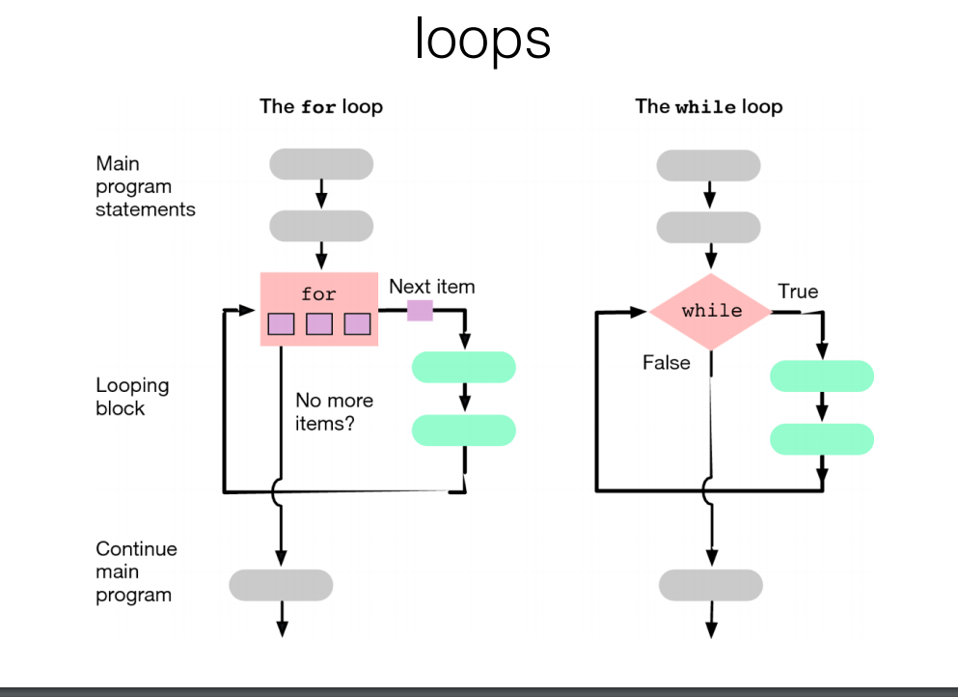
Notes:
There are different types of loops that can be used
For loop – goes through every element you specify and does a task for each until no more items are left.
While loop, has you check whether something is true, conduct something and if false, go straight back to main program.

Slide 17
Chapter 9: Decisions & Loops
View loops on proteincalc.py
How to generate dictionaries
MyDictionary = {key: value, nextkey:nextvalue}
Apply looping skills on DNAcalc.py (create new file)
Notes:
View loops on proteincalc.py
Got to proteincalc.py & write. P. 151 of book
2) Generate dictionaries
Le’ts go on Spyder again
For example:
TaxonGroup={“Lilyopsis”:3, “Physalia”:1, “Nanomia”:2}
print(TaxonGroup["Lilyopsis"])
3) Apply looping skills on DNACalc.py
Go back to Spyder & we’ll write a new program
Note: print('%s: %4.1f' %(Base,Percent))

Slide 18
Chapter 9: Decisions & Loops
Python command-line interpreter
Use dir()
Use of help
Writing if statements, else command
Storing data in dictionaries
Retrieving data in dictionaries
Loops

